Slide 1

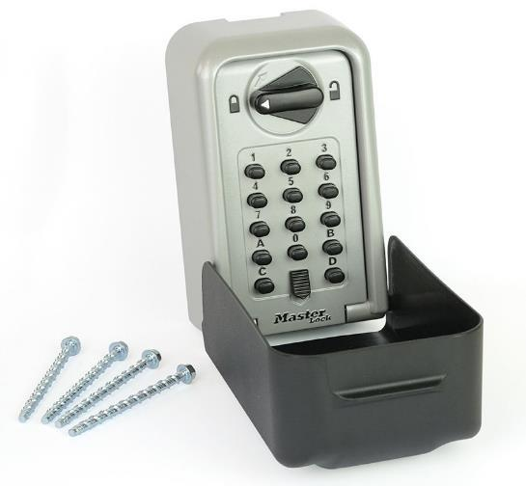



5426EURD – High Security High Capacity Select Access®
The ultimate solution to share keys and access cards safely
Heavy duty construction in Zinc
  Guarantees a high level of resistance against attacks (SBD, SS and CNPP certified)*
Recessed door construction
  Offers more resistance against lever attacks
14 large and easy to use push buttons resettable combination
  Combination can be personalized (Up to 16,000 different codes)
Large clutch to open the front door
  Ergonomic shape, easy to turn
Extra large internal storage capacity
  Accepts multiple keys (all types of keys) & access cards
Removable black weather cover in ABS
  Protects the lock mechanism from natural elements & offers more discretion when not used
Référence | 5426EURD
Code EAN13 | 3-520190-94352-1
Conditionnement | - / 2
Price List £ exc. VAT | £78,00
Launch Date | March 2018
* Certifications in process

